Slide 1
Python class II
Dongho kim

Slide 2
appendex
Class objects
Reg Expression
Sending Email
Multi-threading
Multi-processing
Networking - continue

Slide 3
What is an object?
A software item that contains variable and methods
Object Oriented Design Focuses on
Encapsulation
Dividing the code into a public interface, and private implementation of that interface
Polymorphism
The ability to overload standard operators so that they have appropriate behavior based on their context
Inheritance
The ability to create subclasses that contain specializations of their parents

Slide 4
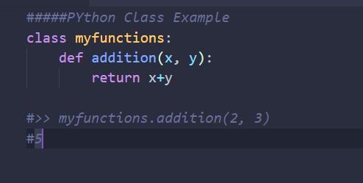
Namespaces
At the simplest level, classes are simply namespaces
It can sometimes be useful to put groups of functions in their own namespace to differentiate these functions from other similarly named ones

Slide 5
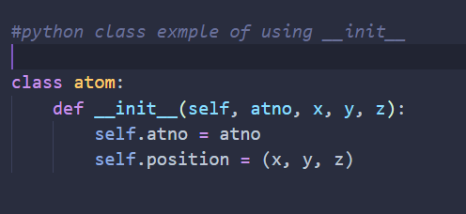
Python classes
Python contains classes that define objects
Objects are instances of class
__init__ is the default constructor
*Self refers to the object itself, like this in java

Slide 6
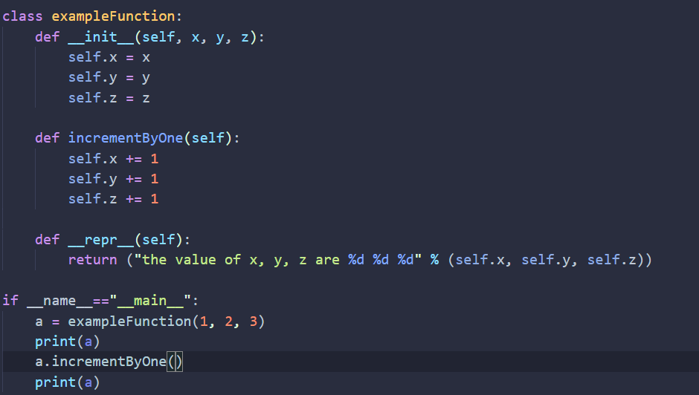
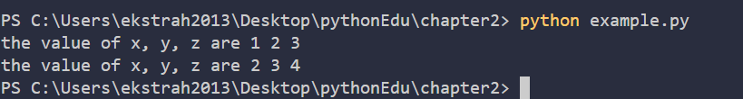
Example: class

Slide 7
Atom class
Overloaded the default constructor
Defined class variables that are persistent and local to the atom object
Good way to manage shared memory:
Instead of passing long lists of arguments, encapsulate some of this data into an object, and pass the object
Much cleaner programs result
Overloaded the print operator
We now want to use the atom class to build molecules

Slide 8
Molecule class
class molecule:
def __init__(self,name='Generic'):
self.name = name
self.atomlist = []
def addatom(self,atom):
self.atomlist.append(atom)
def __repr__(self):
str = 'This is a molecule named %s\n' % self.name
str = str+'It has %d atoms\n' % len(self.atomlist)
for atom in self.atomlist:
str = str + `atom` + '\n'
return str

Slide 9
Using Molecule class
>>> mol = molecule('Water')
>>> at = atom(8,0.,0.,0.)
>>> mol.addatom(at)
>>> mol.addatom(atom(1,0.,0.,1.))
>>> mol.addatom(atom(1,0.,1.,0.))
>>> print mol
This is a molecule named Water
It has 3 atoms
8 0.000 0.000 0.000
1 0.000 0.000 1.000
1 0.000 1.000 0.000
Note that the print function calls the atoms print function
Code reuse: only have to type the code that prints an atom once; this means that if you change the atom specification, you only have one place to update.

Slide 10
inheritance
class qm_molecule(molecule):
def addbasis(self):
self.basis = []
for atom in self.atomlist:
self.basis = add_bf(atom,self.basis)
__init__, __repr__, and __addatom__ are taken from the parent class (molecule)
Added a new function addbasis() to add a basis set
Another example of code reuse
Basic functions don't have to be retyped, just inherited
Less to rewrite when specifications change

Slide 11
Overloading
class qm_molecule(molecule):
def __repr__(self):
str = 'QM Rules!\n'
for atom in self.atomlist:
str = str + `atom` + '\n'
return str
Now we only inherit __init__ and addatom from the parent
We define a new version of __repr__ specially for QM

Slide 12
Adding to parent function
Sometimes you want to extend, rather than replace, the parent functions.
class qm_molecule(molecule):
def __init__(self,name="Generic",basis="6-31G**"):
self.basis = basis
molecule.__init__(self,name)
add additional functionality
to the constructor
call the constructor
for the parent function

Slide 13
Encapsulated Atom
class atom:
def __init__(self,atno,x,y,z):
self.atno = atno
self.__position = (x,y,z) #position is private
def getposition(self):
return self.__position
def setposition(self,x,y,z):
self.__position = (x,y,z) #typecheck first!
def translate(self,x,y,z):
x0,y0,z0 = self.__position
self.__position = (x0+x,y0+y,z0+z)

Slide 14
Why Encapsulate?
By defining a specific interface you can keep other modules from doing anything incorrect to your data
By limiting the functions you are going to support, you leave yourself free to change the internal data without messing up your users
Write to the Interface, not the the Implementation
Makes code more modular, since you can change large parts of your classes without affecting other parts of the program, so long as they only use your public functions

Slide 15
UNDerstandin regular expression
Very powerful and quite cryptic
Fun once you understand them
Regular expressions are a language unto themselves
A language of "marker characters" - programming with characters
It is kind of an "old school" language - compact

Slide 16
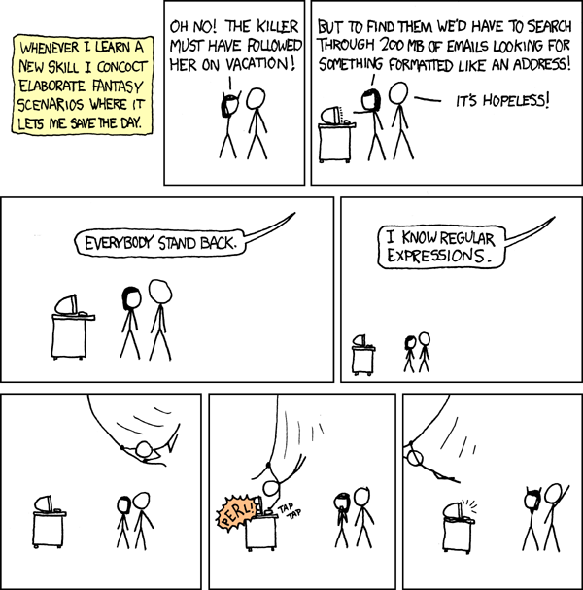

Slide 17
Regular Expression Quick Guide
^ Matches the beginning of a line
$ Matches the end of the line
. Matches any character
\s Matches whitespace
\S Matches any non-whitespace character
* Repeats a character zero or more times
*? Repeats a character zero or more times (non-greedy)
+ Repeats a chracter one or more times
+? Repeats a character one or more times (non-greedy)
[aeiou] Matches a single character in the listed set
[^XYZ] Matches a single character not in the listed set
[a-z0-9] The set of characters can include a range
( Indicates where string extraction is to start
) Indicates where string extraction is to end

Slide 18
The Regular Expression Module
Before you can use regular expressions in your program, you must import the library using "import re"
You can use re.search() to see if a string matches a regular expression similar to using the find() method for strings
You can use re.findall() extract portions of a string that match your regular expression similar to a combination of find() and slicing: var[5:10]

Slide 19
Using re.search() like find()
import re
hand = open('mbox-short.txt')
for line in hand:
line = line.rstrip()
if re.search('From:', line) :
print (line)
hand = open('mbox-short.txt')
for line in hand:
line = line.rstrip()
if line.find('From:') >= 0:
print (line)

Slide 20
Multi threading and multi processing
Each folder will include studying material
The threading module uses threads, the multiprocessing module uses processes.
The difference is that threads run in the same memory space, while processes have separate memory.
This makes it a bit harder to share objects between processes with multiprocessing.
Since threads use the same memory, precautions have to be taken or two threads will write to the same memory at the same time.
This is what the global interpreter lock is for.
Spawning processes is a bit slower than spawning threads. Once they are running, there is not much difference.

Slide 21
Certain perspective of python
Python is generally much slower than most of other language
So it is not ideal to use this language for faster performance.
However, there are multiple ways of boosting the speed while coding

Slide 22
Example 1
How to create and set increment value into it?
a = [0, 1, 2, 3, 4, …, n]
How to create certain number of lists?
a = [ 1, 2, 3, 4, 5, 6] is 7
Function Overide?
a = None
Removing certain duplicates in list
using set?
Two or more inputs?
Addition of two lists
[1, 2, 3] + [4, 5, 6] = [5, 7, 9]
Notes:
map(add, list1, list2)
[sum(x) for x in zip(list1, list2)]
x = np.array([1,2,3]) y = np.array([2,3,4]) print x+y
print map(lambda x,y:x+y, list1, list2)

Slide 23
Example 2
From the above idea can you make this code shorter?
>>a = int(input())
>>b = []*a
>>for I in range(0, a):
>> b[i] = int(input())
Notes:
map(add, list1, list2)
[sum(x) for x in zip(list1, list2)]
x = np.array([1,2,3]) y = np.array([2,3,4]) print x+y
print map(lambda x,y:x+y, list1, list2)

